Slide 1
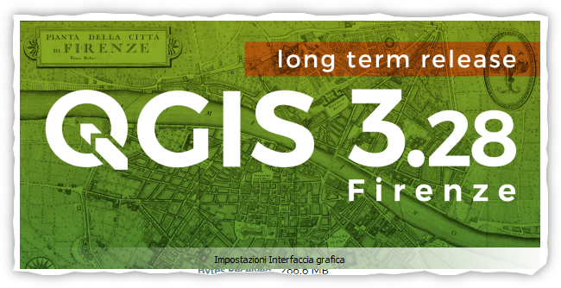
SmartGrids Course Lab 2 – Introduction to Geographic Information Systems (GIS)
Vinicius Gadelha - PhD candidate in Electrical Engineering
vinicius.gadelha@upc.edu

Slide 2
Summary
What is GIS?
Coordinate systems
Data types used in geoprocessing
What is it used for?
QGIS Software
Exercise 4

Slide 3
What is GIS?
GIS is a system designed to manage and analyze spatial and geographic data.
Modern systems use ortho-rectified satellite imagery as an accurate map background in a GIS software, in which several layers of information will be placed on top of this background.
The most powerful aspect of a GIS is to relate otherwise unrelated information by using space and location as a common index.
For that, all those information must be interpreted using the same coordinate system.

Slide 4
Geographic Coordinate System (GCS)
The GCS is a three-dimensional coordinate system of a sphere or spheroid.
It maps the exact location of an object using latitude and longitude measured in degrees unit. For example, the GPS uses the most well-known coordinate system WGS 84.
Latitude is the distance from equator line (Y) and longitude the distance from Greenwich meridian (X).
What we do in GIS is to “translate” the objects and project it into the map, in a specific Coordinate Reference System (CRS)

Slide 5
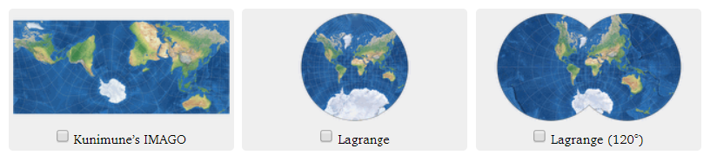
Coordinate Reference System (CRS)
A CRS defines a specific coordinate-based projection, which represents the geographical position of an object in a map.
When creating a map projection we have to flatten the globe's surface into a plane, which will inevitably incur in some sort of information loss due to distortion.
For this reason different map projections exist in order to preserve some properties at the expense of others (distances, shapes, areas etc.).
Notes:
For example some prefer to proper represent distances (equidistant projections), some others are focused on the proper display of the areas (equal-area projections) or shapes (conformal projections).

Slide 6
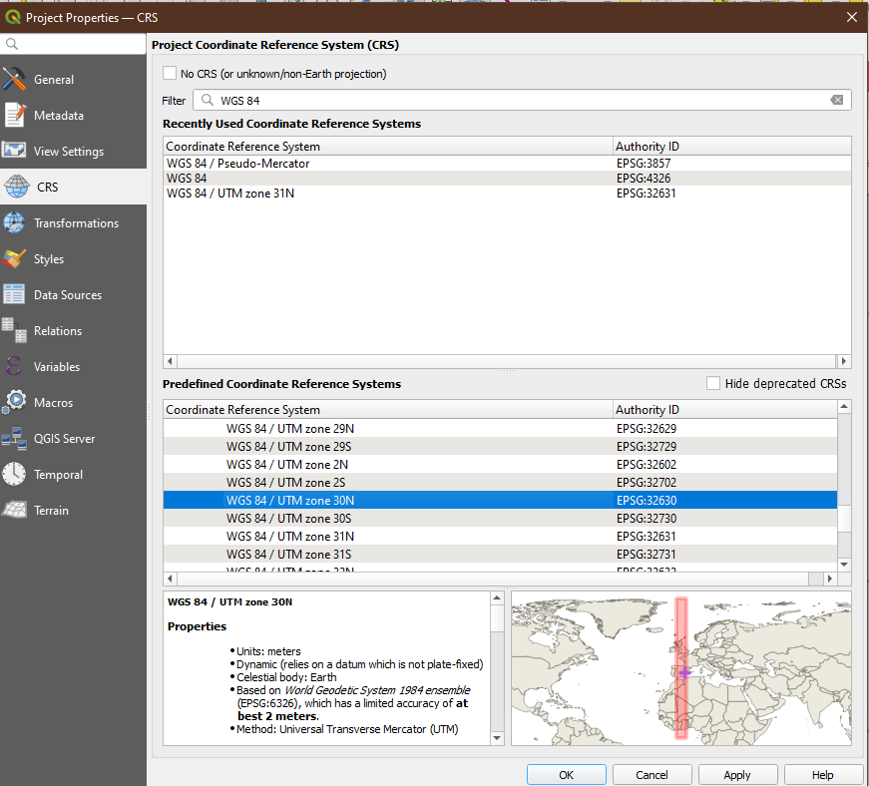
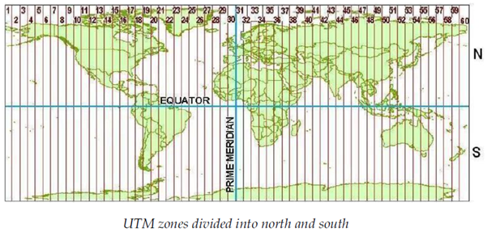
Coordinate Reference System (CRS)
One way to reduce projection distortions is to reduce the area of interest.
The Universal Transverse Mercator (UTM) divides the world into 60 equal zones, 6 degrees of longitude wise.

Slide 7
Data types used in geoprocessing
There are two main types of data that are used as input in GIS software: vector and raster.
Raster data
Made of a matrix of pixels (also called cells) and each of them contains a value assigned (also called band).
Better suited to display information that changes in a continuous way across an area.
This is the case for satellite images. The higher the resolution of the image the higher is the amount of pixels it contains and therefore a better accuracy is obtained.

Slide 8
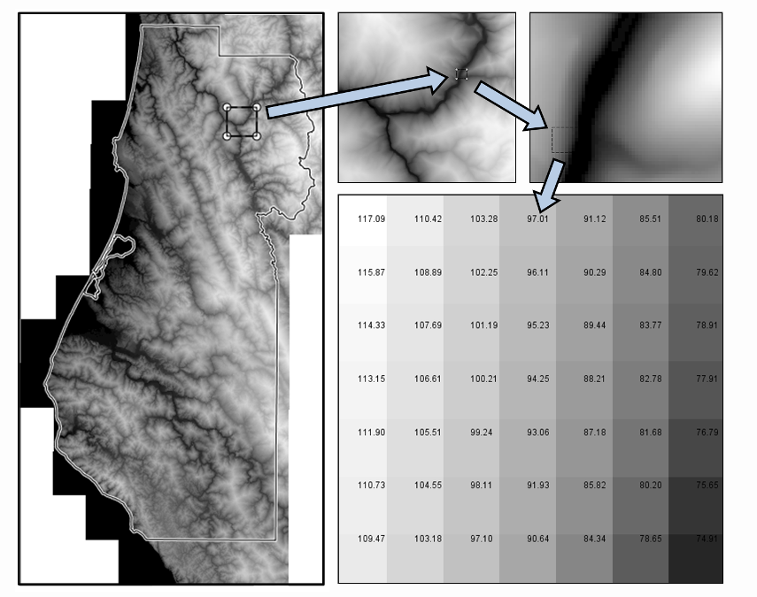
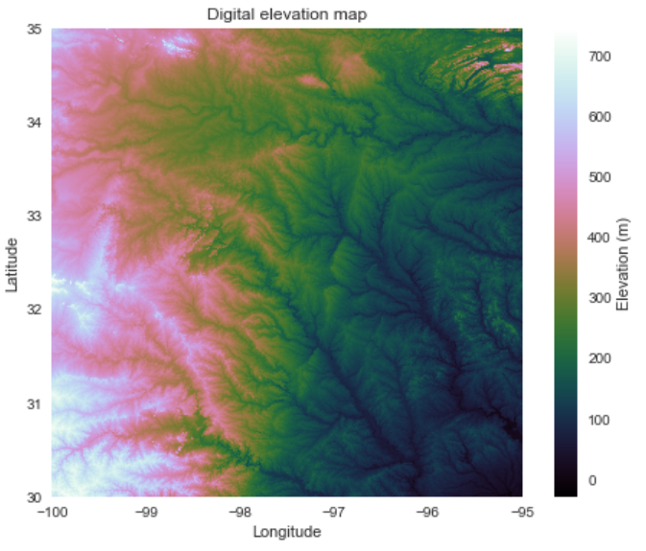
Data types used in geoprocessing
Raster data examples

Slide 9
Data types used in geoprocessing
Vector data
Vector data, instead of images, use specific types of geometry to represent the features present in the real world.
These geometries can be a single vertex (point), lines or areas (polygons).
Examples of features that can be representend in vector data are powerplant and substation locations (points), power lines and roads (lines), neighbourhood boundaries and roof areas (polygon).

Slide 10
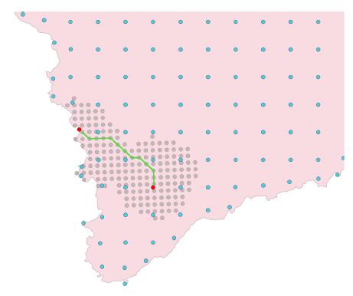
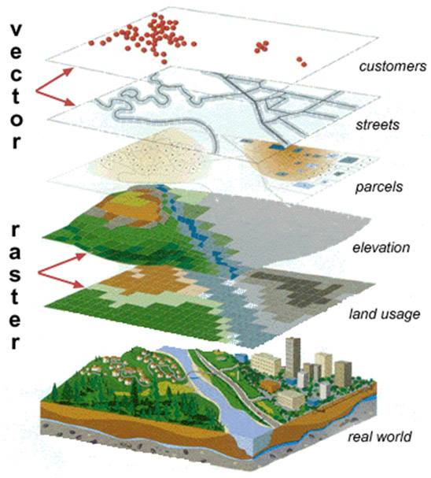
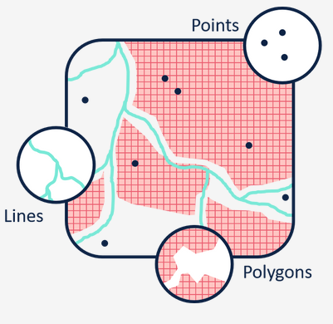
Data types used in geoprocessing
Vector data examples

Slide 11
What is it used for?
With today’s amount of information available, GIS quickly became one of the most powerful tools used for a wide range of applications across various fields, examples:
Urban Planning: Analyzing and managing urban areas by mapping land use, transportation networks, infrastructure, and demographics.
Environmental Management: Monitoring and managing natural resources, tracking environmental changes, and assessing the impact of human activities on ecosystems.
Public Health: Analyzing the spread of diseases, tracking health trends, and planning healthcare services based on geographic factors.
Business and Marketing: Location-based analysis for site selection, market research, and target audience identification in business and marketing strategies.

Slide 12
What is it used for?
In Electrical Engineering it is also becoming quite useful:
Grid Modelling: Map information about electrical assets, such as substations, transformers, power lines, and other components. Most advanced DSOs have a GIS-embed system integrated with SCADA.
Renewable Energy Integration: Selecting suitable locations for renewable energy sources, such as wind and solar farms. It helps in assessing factors like solar irradiance, wind speed, and land use.
Network Planning and Design: Analyze geographic data for optimal planning and design of electrical networks. This includes determining the most efficient routes for power lines and locating substations based on factors like terrain, population density, and environmental considerations.

Slide 13
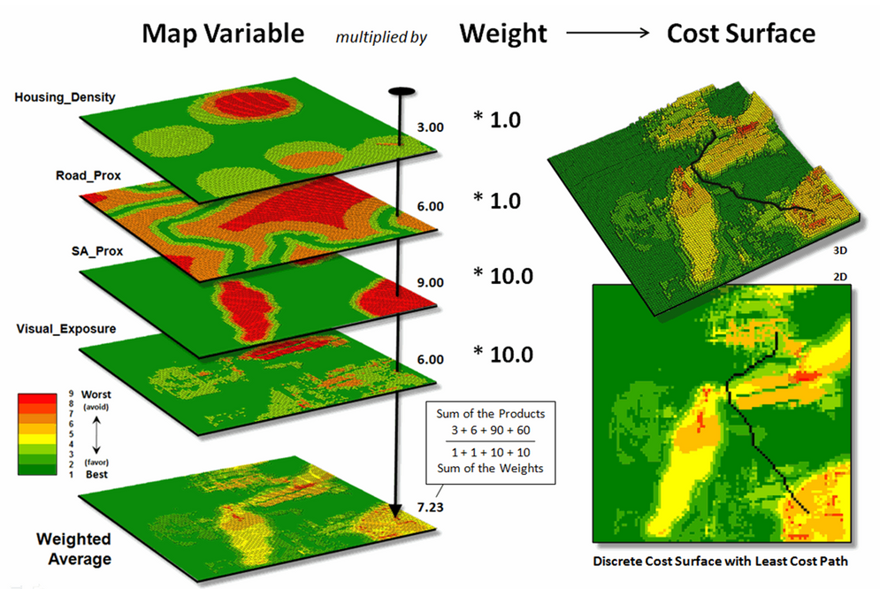
What is it used for?

Slide 14
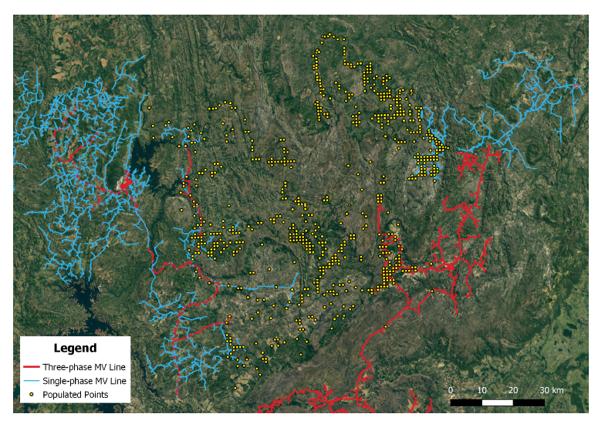
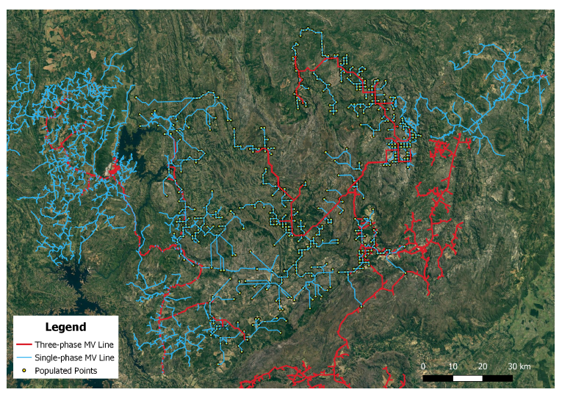
What is it used for?

Slide 15
Let’s get to work!
1 - Open QGIS -> New Empty Project -> Add background (XYZ Tiles)
2 – Create new point layer with the following attributes (name, voltage, type)
3 – Edit layer to add all the points given by the file “buses_table.xlsx”
4 – Reproject the layer to EPSG:4326
5 – Create a line layer connecting the points as the Final Project grid (you can use Points to Path function)
6 – Use the “Measure” tool to find the line lenghts.

Slide 16
Exercise 4
1 – Create a pandapower network with the coordinates and elements given in the course project.
2 – Run a power flow.
3 – Plot the results on map using the pf_res_plotly() function.
4 – Add a picture of the results and the res_bus table to your report.

Slide 17
SmartGrids Course Lab 2 – Introduction to Geographic Information Systems (GIS)
Vinicius Gadelha - PhD candidate in Electrical Engineering
vinicius.gadelha@upc.edu

